Slide 1

Automated Essay Grader
Jake Bialer, Drace Zhan
Github

Slide 2
The Numbers:
Over four million students take standardized exams that include an essay section
The most popular exam, the ACT, reports two additional weeks to process essay grades
Typically two graders are required per essay to create an aggregate score
Assuming that each grader requires on average one minute to grade an essay, this approximates to about 67,000 manhours
By automating part of the process to replace one grader, this can save more than one million USD from the industry

Slide 3
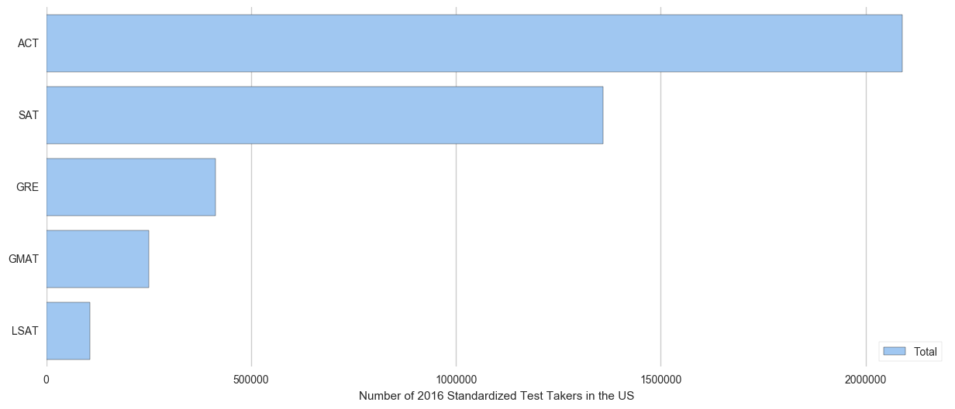
Standardized Exams That Includes An Essay Section

Slide 4
The Process
Input
Feature
Extraction
Models
Predictions
Grading Factors
Gradient Boosted Trees
Essay Text
Scores & Probability Distribution
Natural Language Processing
Neural Networks
Training Samples

Slide 5
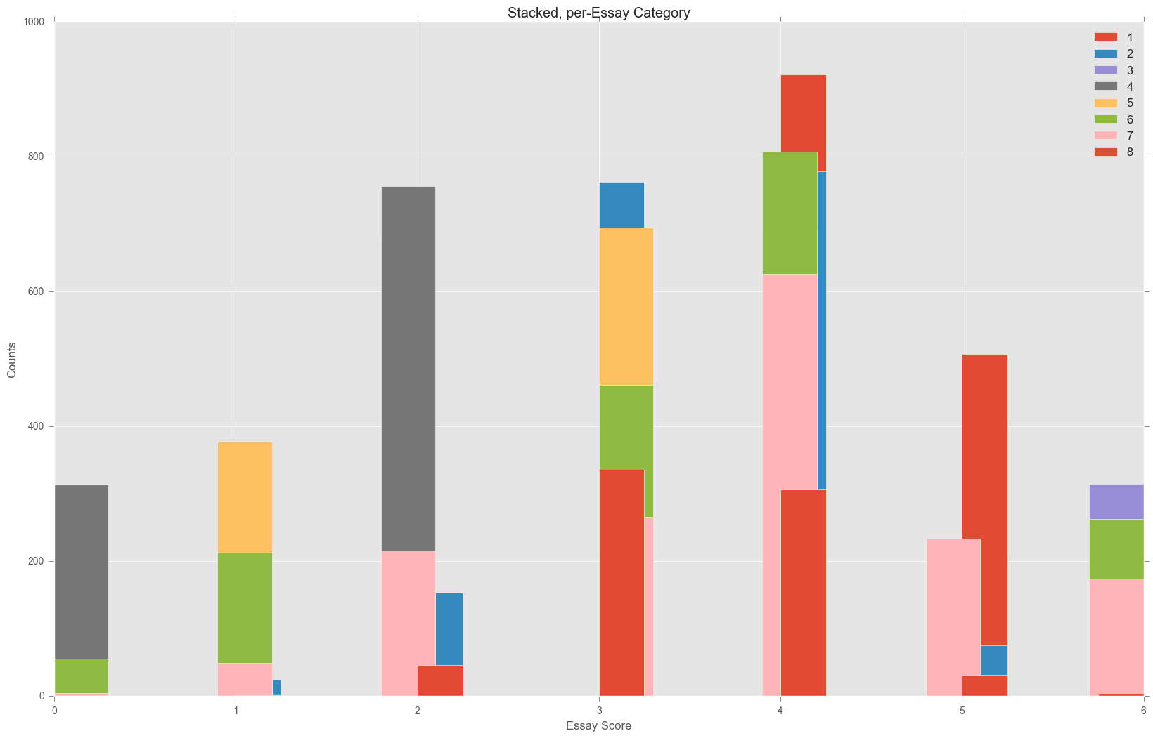
Stacked Essay Category Comparison of Essay Score
From Training Data

Slide 6
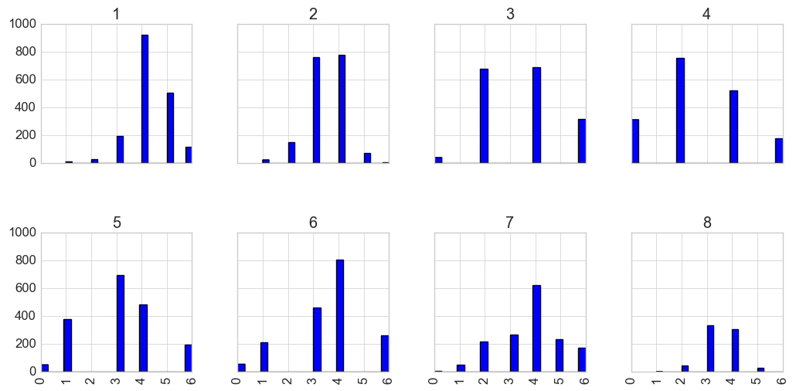
Unstacked Display of Distribution of Topics & Scores Assigned

Slide 7
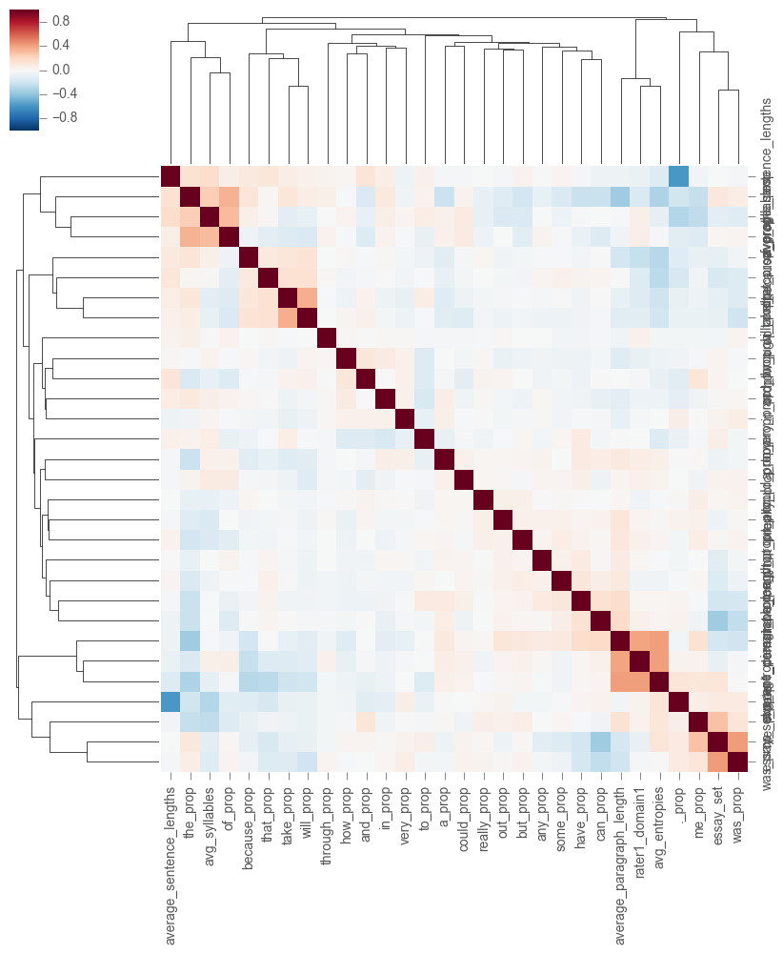
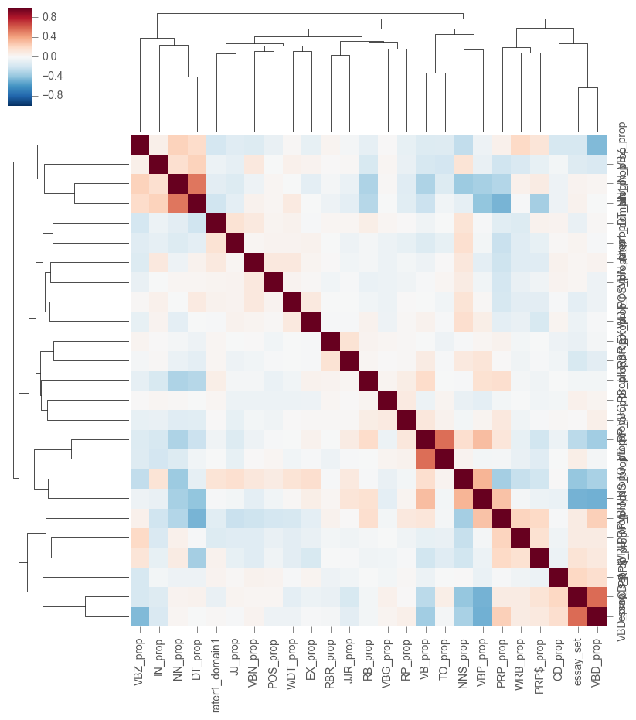
Examination of Engineered Features

Slide 8
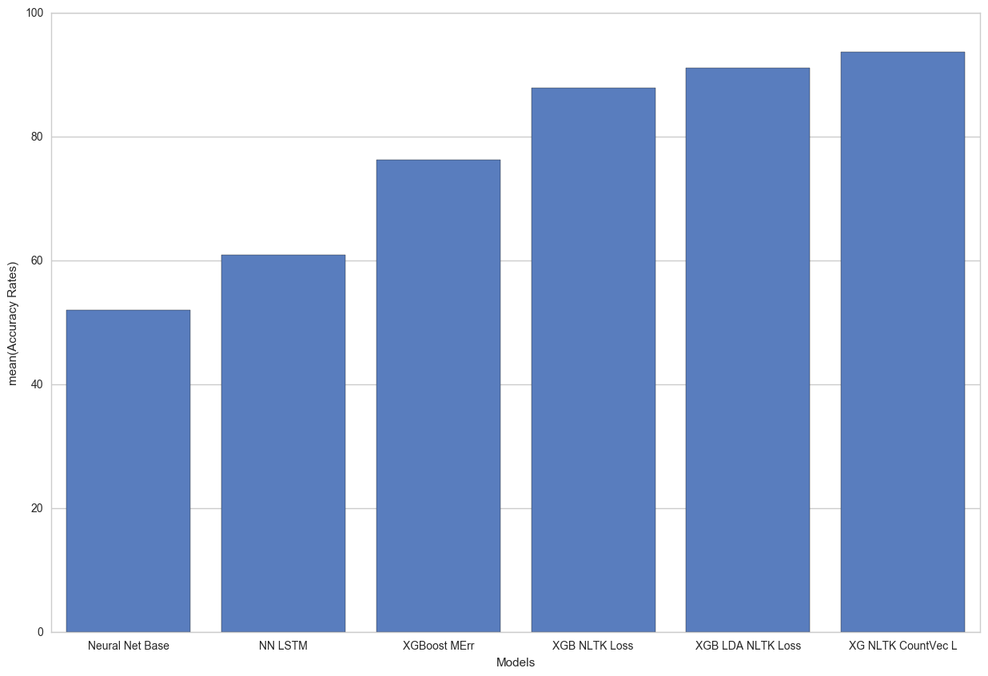
Accuracy Ratings across Models and Features

Slide 9
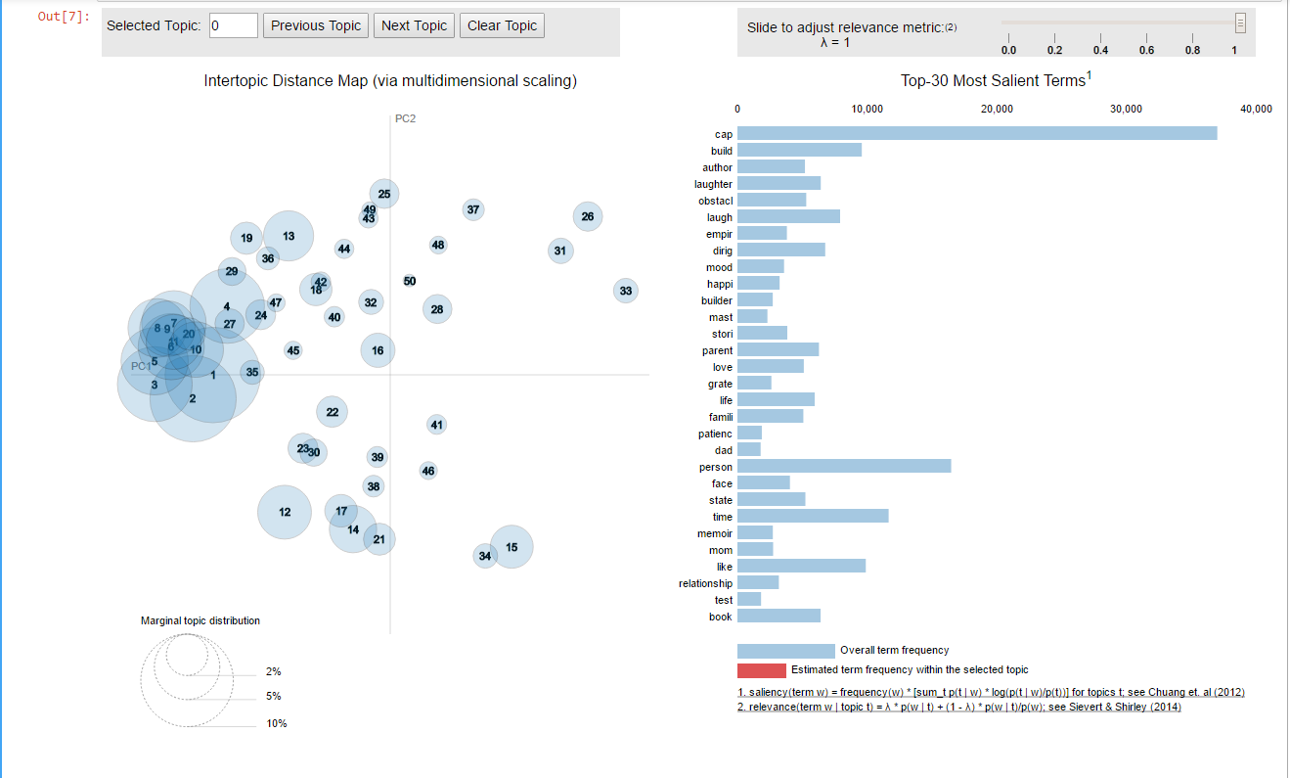
Topic Modeling of Corpus using Gensim & PyLabVis

Slide 10
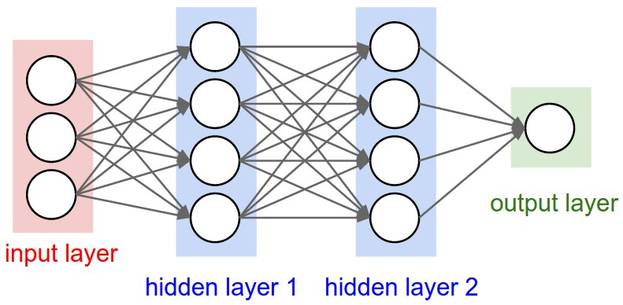
Neural Network Used

Slide 11
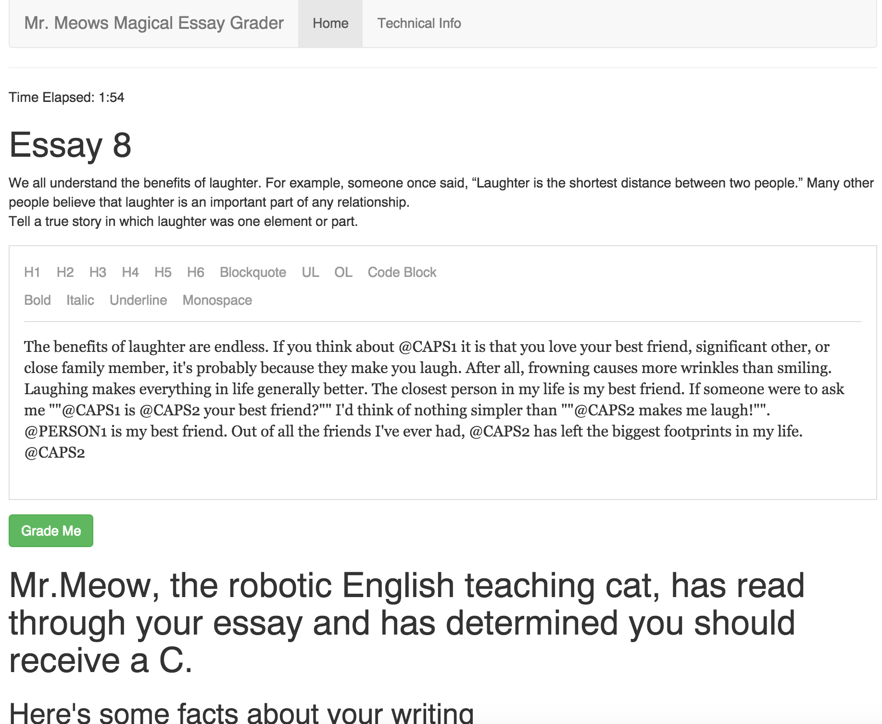
The App in Effect

Slide 12
Future Additions
Extra feature extraction such as Flesch Kincaid Grade for model inputs
Larger corpus such as wikipedia
Further tuning of neural network parameters
More clarity on features selected for grading parameters
Additional tips for improvement of writing for student feedback

Slide 13

Finally ...
Many thanks to Zeyu Zhang, the bootcamp of January 2017, and the rest of NYC Data Science Academy for making giving our team the opportunity to make this possible

